Slide 1
Performing AC Analyses on PFC Converters
March 28, 2017
Chris Bridge
Tom Wilson
SIMPLIS Technologies

Slide 2
Agenda
The Importance of Finding Steady-State
  Natural and Forced Response
  The State-Plane
POP/AC Analysis on PFC circuits
  AC Line vs. DC Line
  PFC: Continuous Conduction Mode
  PFC: Critical Conduction Mode
Multi-Tone AC Analysis
  PFC: Continuous Conduction Mode
  PFC: Critical Conduction Mode
Current Loop and Input and Output Impedance

Slide 3
Agenda
The Importance of Finding Steady-State
  Natural and Forced Response
  The State-Plane
POP/AC Analysis on PFC circuits
  AC Line vs. DC Line
  PFC: Continuous Conduction Mode
  PFC: Critical Conduction Mode
Multi-Tone AC Analysis
  PFC: Continuous Conduction Mode
  PFC: Critical Conduction Mode
Current Loop and Input and Output Impedance

Slide 4
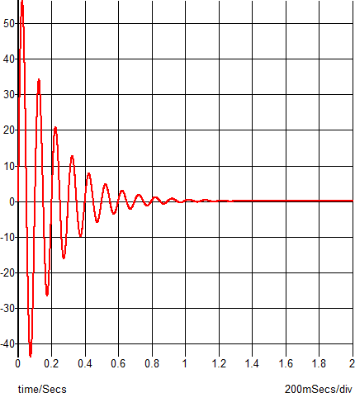
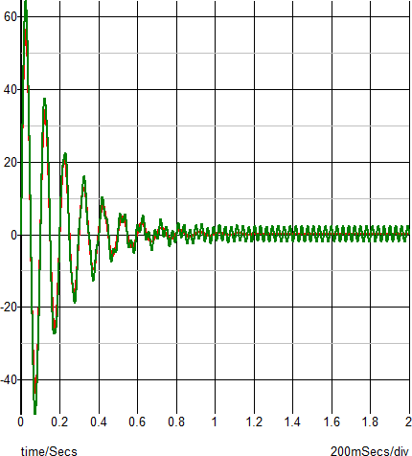
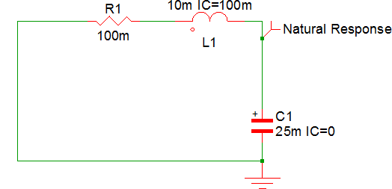
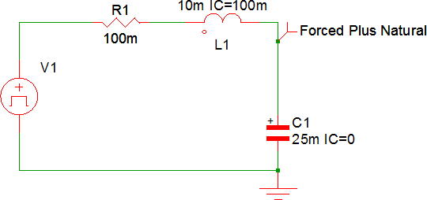
The Importance of Finding Steady-State
A system must be operating in steady state in order to perform a valid AC analysis
Example: Series RLC with Natural and Forced Response
IN
OUT
AC Response
OUT/IN

Slide 5
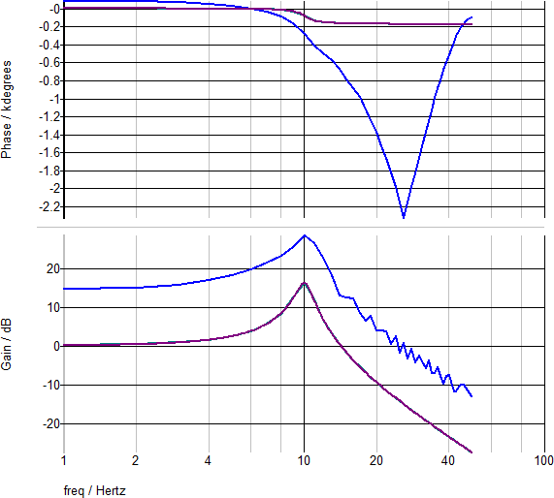
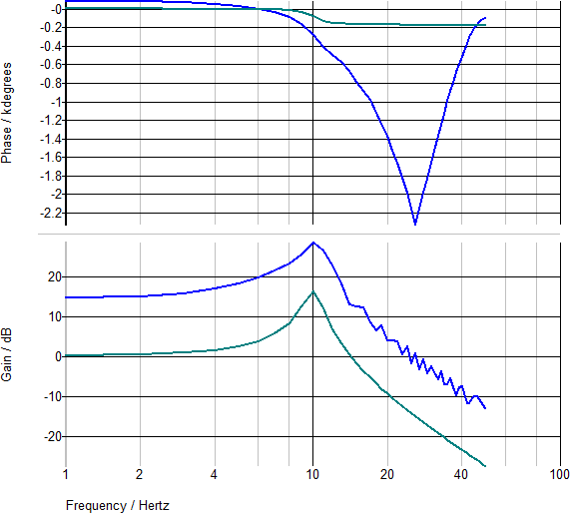
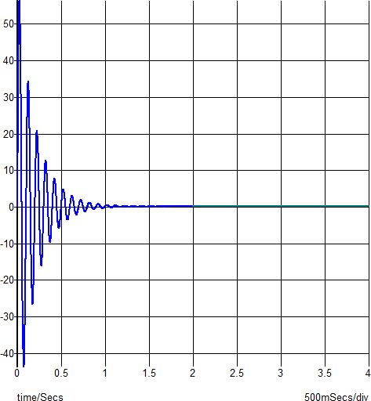
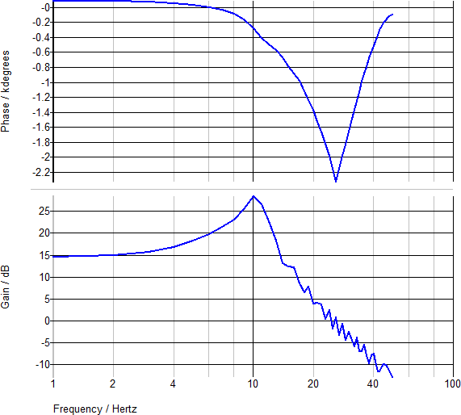
Multi-Tone AC Results Using different “Time Slices”
0 to 2 seconds
Not in Steady-State
Steady-State
15dB?
2 to 4 seconds
POP/AC

Slide 6
Viewing PFC Performance in the State Plane
Recognize that the Dominant Energy Storage Elements are the Power Inductor and Output Capacitor
Define an X-Y Plot with the Inductor Current Plotted on y- Axis and the Output Capacitor Voltage on x-Axis
Time is now an Implicit Variable
Lowest Periodic System Behavior => ½ the Line Period

Slide 7
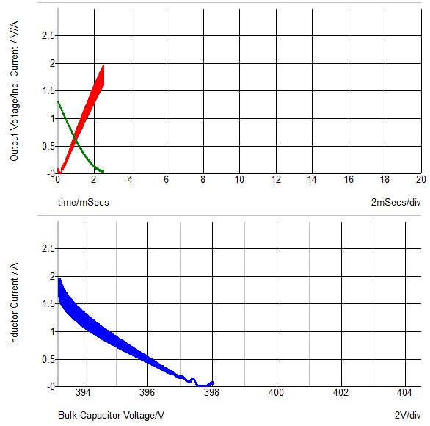
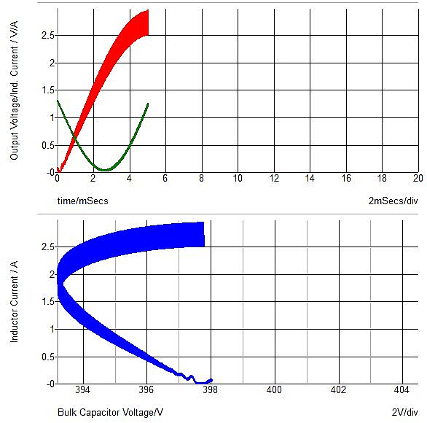
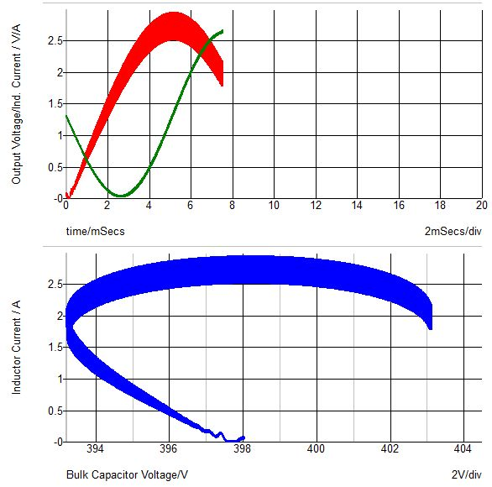
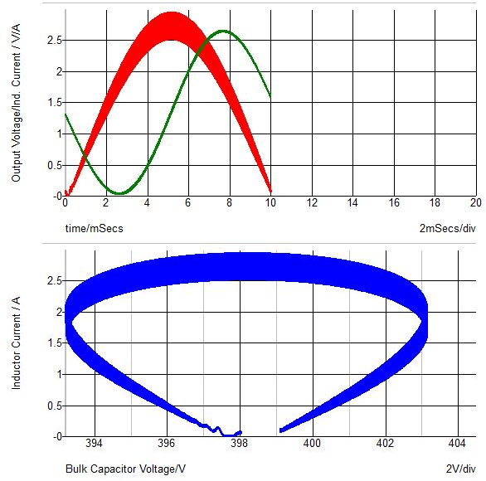
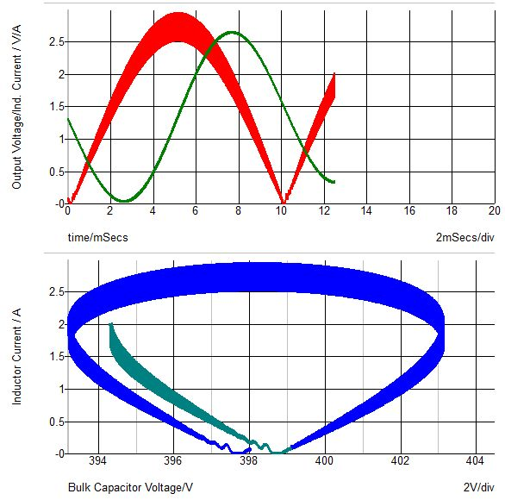
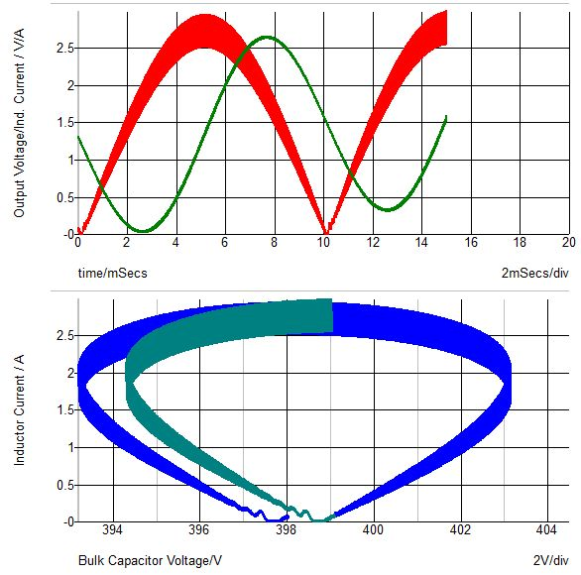
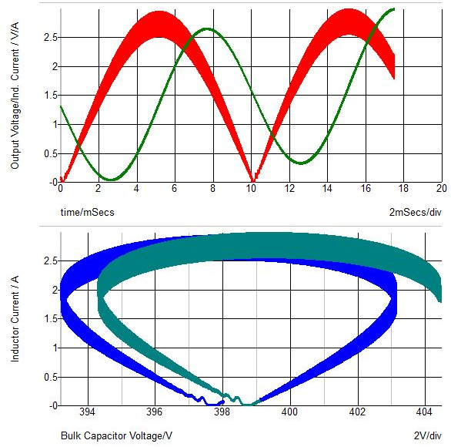
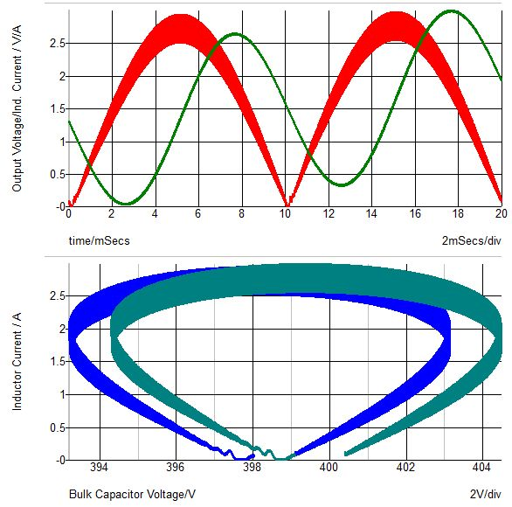
Dominant Energy Storage Elements of PFC in State-Plane
Inductor Current
Output Voltage
State-Plane
1st Half-Cycle
2nd Half-Cycle
Inductor Current
Output Voltage

Slide 8
Is This PFC Converter in Steady-State?
Inductor Current
Output Voltage
State-Plane
1st Half-Cycle
2nd Half-Cycle
Inductor Current
Output Voltage

Slide 9
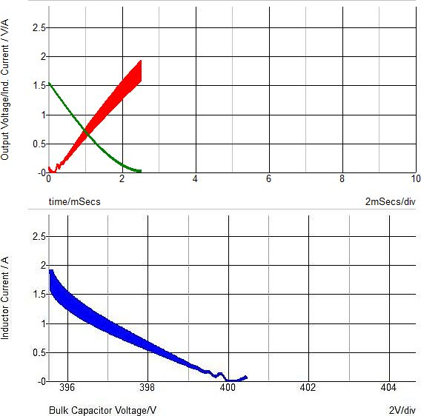
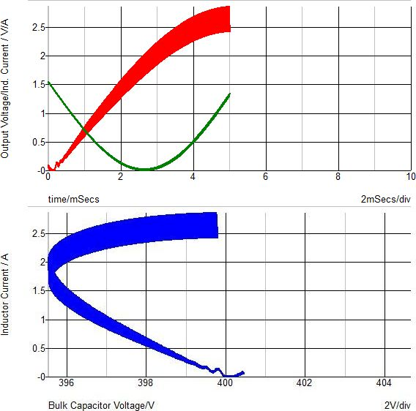
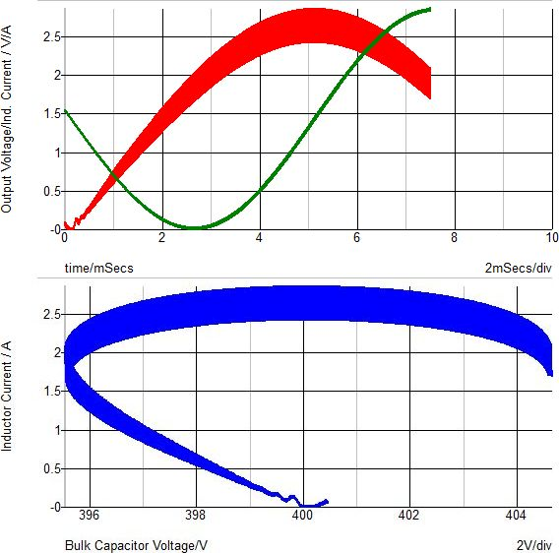
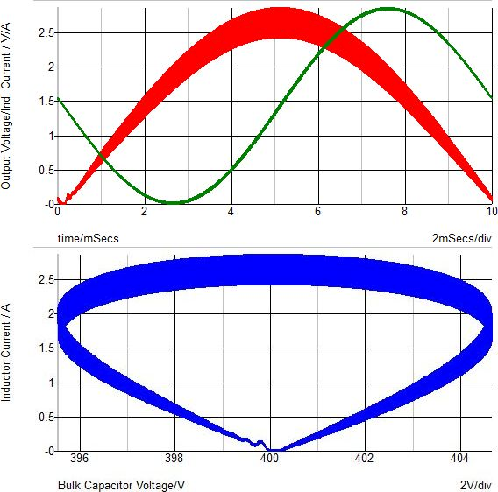
What Steady-State Looks Like on State-Plane
Inductor Current
Output Voltage
State-Plane
Inductor Current
Output Voltage

Slide 10
Six Switching Cycles Around 10ms
Inductor Current
Output Voltage
State-Plane
Inductor Current
Output Voltage

Slide 11
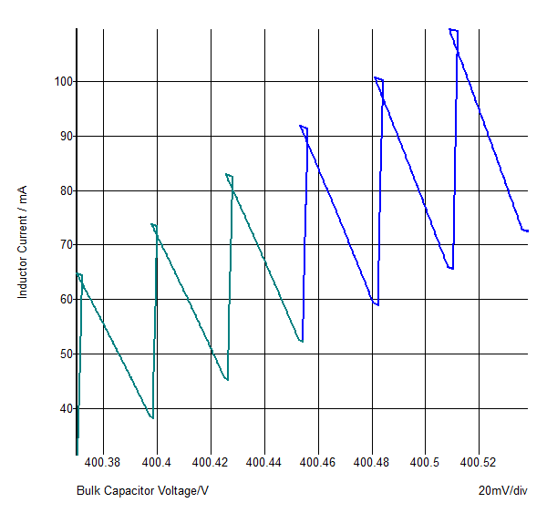
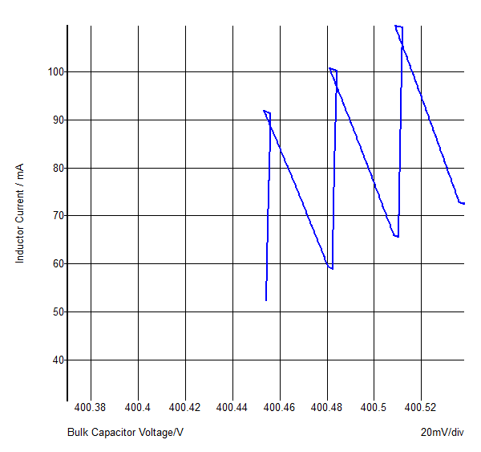
Six Switching Cycles Around 10ms
State-Plane
Inductor Current
Output Voltage

Slide 12
State-Plane Progression

Slide 13
Steady-State – AC Line
Inductor Current
Output Voltage
State-Plane
Inductor Current
Output Voltage

Slide 14
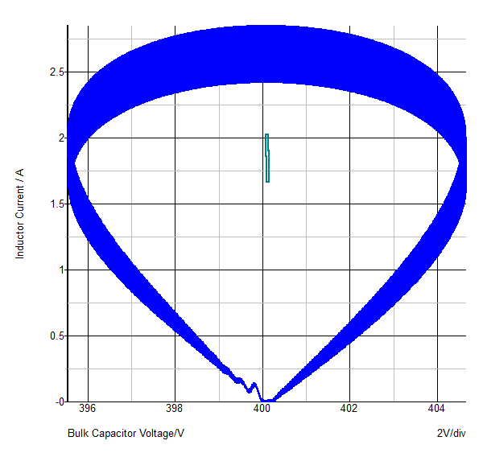
Steady-State – AC Line, DC Line
Inductor Current
State-Plane
Output Voltage

Slide 15
Summary of Methods for Finding Steady-State
AC Line:
  POP Analysis – Trigger on AC Line
  Long Transient – Use Multi-Tone AC Analysis
DC Line:
  POP Analysis – Trigger on Switching Frequency
  Long Transient – Use Multi-Tone AC Analysis

Slide 16
Agenda
The Importance of Finding Steady-State
  Natural and Forced Response
  The State-Plane
POP/AC Analysis on PFC circuits
  AC Line vs. DC Line
  PFC: Continuous Conduction Mode
  PFC: Critical Conduction Mode
Multi-Tone AC Analysis
  PFC: Continuous Conduction Mode
  PFC: Critical Conduction Mode
Current Loop and Input and Output Impedance

Slide 17

AC Line vs. DC Line
We will show that the AC analysis of a PFC Converter operating off a DC Line voltage is similar to the same converter operating from a AC Line.
DC Line Voltage is Set to the RMS Value of the AC Line
Why? Consider the state-plane:

Slide 18
POP/AC Analysis on PFC circuits - Rules
AC Line
  Line Frequency Must be a Harmonic of the (constant) Switching Frequency
  Example: 50Hz line, and 100kHz Switching Frequency
  For AC Line with Variable Switching Frequency, use Multi-Tone AC Analysis
DC Line
  AC/DC Converter is Reduced to a DC/DC Converter
  Works on Converters with Constant or Variable Switching Frequency
  Extremely Fast when Compared to AC Line

Slide 19
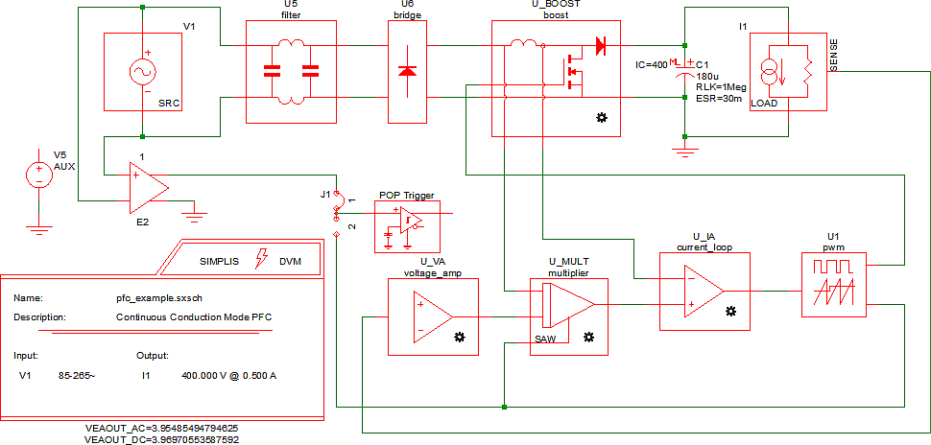
Continuous Conduction Mode PFC

Slide 20
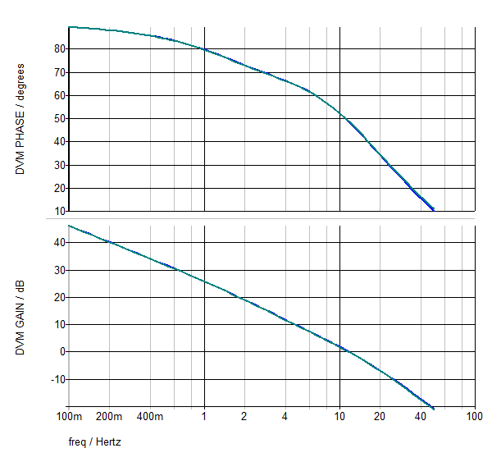
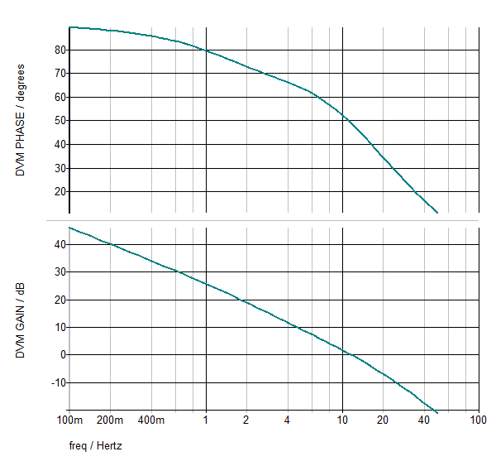
Continuous Conduction Mode PFC – POP/AC Results -- DC Line vs. AC Line
Voltage Loop:
DC Line
AC Line

Slide 21
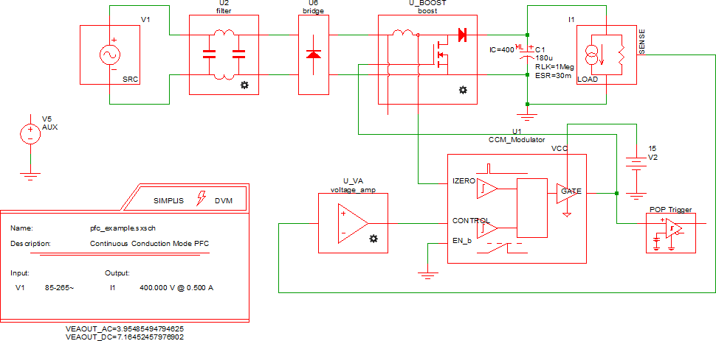
Critical Conduction Mode PFC

Slide 22
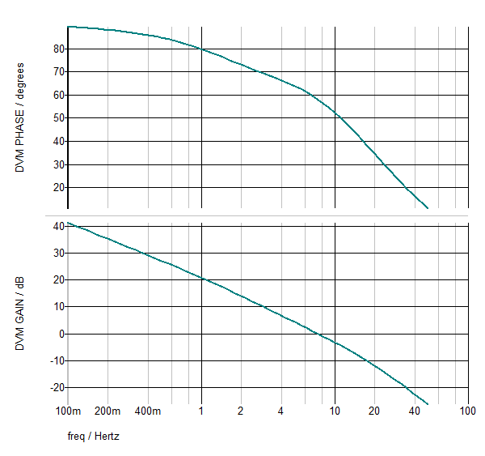
Critical Conduction Mode PFC – POP/AC Results – DC Line
Voltage Loop:
DC Line

Slide 23
Agenda
The Importance of Finding Steady-State
  Natural and Forced Response
  The State-Plane
POP/AC Analysis on PFC circuits
  AC Line vs. DC Line
  PFC: Continuous Conduction Mode
  PFC: Critical Conduction Mode
Multi-Tone AC Analysis
  PFC: Continuous Conduction Mode
  PFC: Critical Conduction Mode
Current Loop and Input and Output Impedance

Slide 24
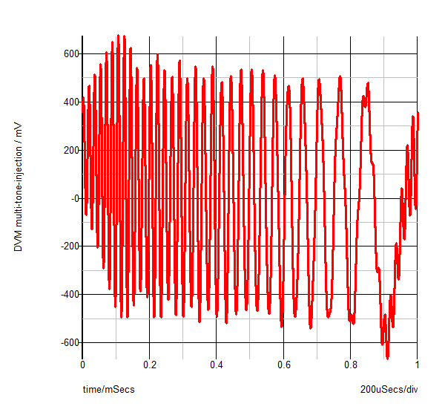
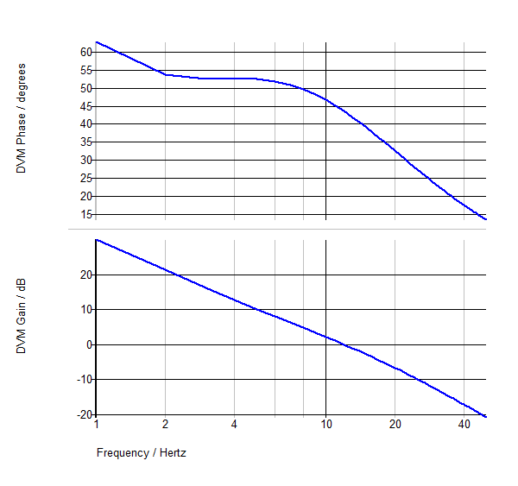

Multi-Tone Concept
Inject multiple frequencies concurrently into a feedback loop during a time domain simulation
Y
50 “tones” 1Hz ~ 50Hz
Post-process
w/ Fourier:
Loop Gain = Y/X
Phase
…
Injection
Source
Gain
X

Slide 25
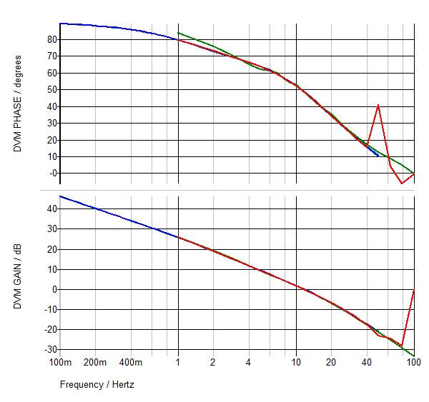
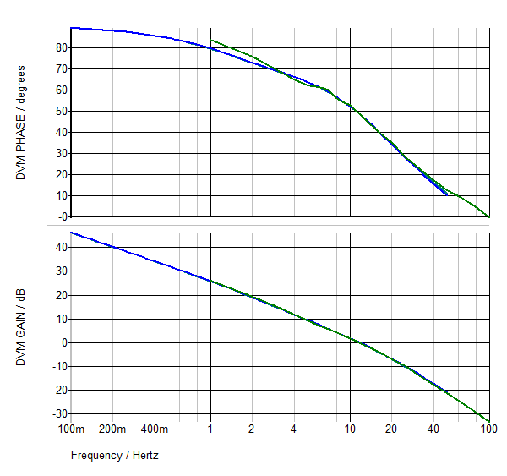
Continuous Conduction Mode PFC – POP/AC vs. Multi-Tone AC Results
Voltage Loop:
DC Line – POP/AC
AC Line – POP/AC
DC Line – Multi-Tone
AC Line – Multi-Tone

Slide 26
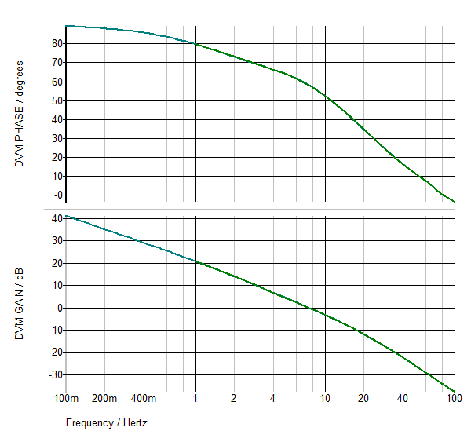
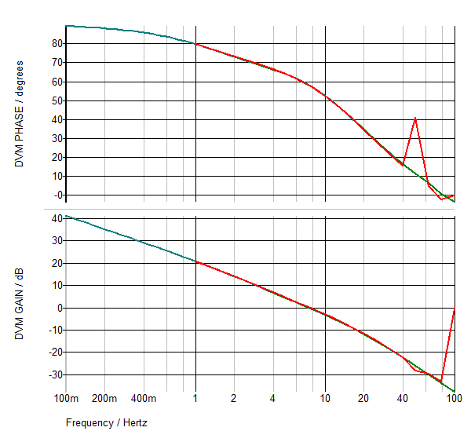
Critical Conduction Mode PFC – Multi-Tone AC Results – DC Line, AC Line
Voltage Loop:
DC Line – POP/AC
DC Line – Multi-Tone
AC Line – Multi-Tone

Slide 27
Agenda
The Importance of Finding Steady-State
  Natural and Forced Response
  The State-Plane
POP/AC Analysis on PFC circuits
  AC Line vs. DC Line
  PFC: Continuous Conduction Mode
  PFC: Critical Conduction Mode
Multi-Tone AC Analysis
  PFC: Continuous Conduction Mode
  PFC: Critical Conduction Mode
Current Loop and Input and Output Impedance

Slide 28
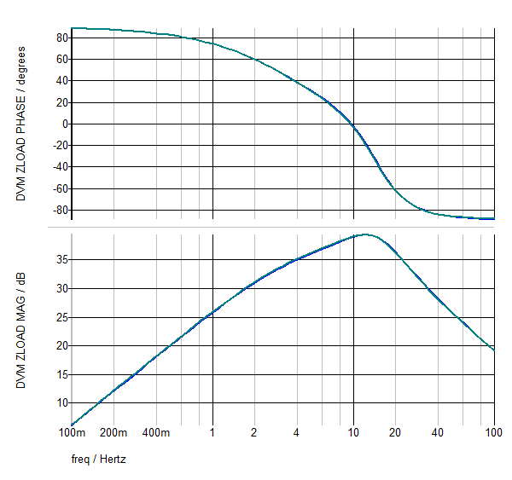
Critical Conduction Mode:
PFC Output Impedance
DC Line – POP/AC
AC Line – POP/AC

Slide 29
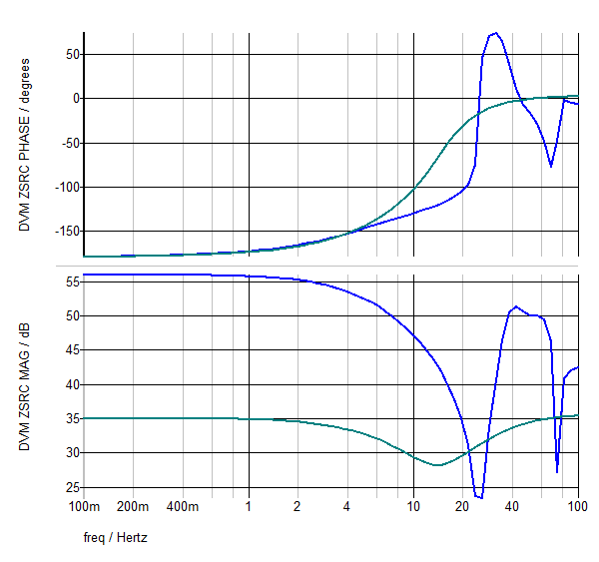
Critical Conduction Mode:
PFC Input Impedance
DC Line – POP/AC
AC Line – POP/AC

Slide 30
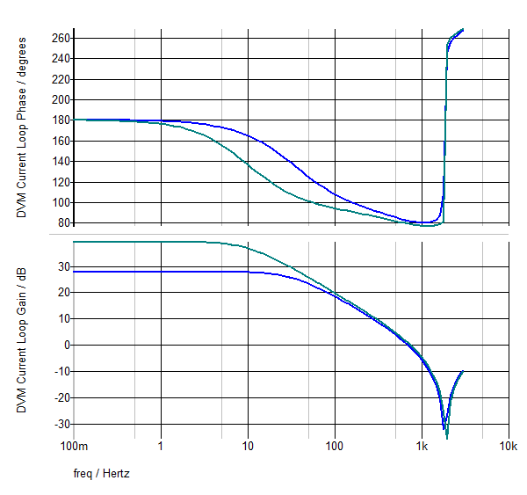
Critical Conduction Mode:
PFC Current Loop
DC Line – POP/AC
AC Line – POP/AC

Slide 31
Simulation Time Comparison
Case | Input Voltage | CPU Time to Steady State | CPU Time for AC Analysis
AC Line, Multi-Tone AC | 115 VRMS AC | 238 sec | 304 sec
DC Line, Multi-Tone AC | 115 V DC | 240 sec | 322 sec
AC Line POP/AC | 115 VRMS AC | 76 sec | 88 sec
DC Line POP/AC | 115 V DC | 1 sec | 1 sec
Gain and Phase results are almost Identical, but…
Simulation times are very different !
If feasible, SIMPLIS POP and AC are much faster

Slide 32
Summary
For PFC Voltage Loop and Z_{out}
  DC Line input yields the same simulation results as the AC Line, but at a greatly reduced simulation time
  AC line results using POP/AC and Multi-Tone AC are nearly identical
PFC Current Loop response changes depending on AC Line vs. DC Line
  This impacts Z_{in}

Slide 33
Resources
Presentation:
  http://simplis.com/news/apec-2017
Webinar on this Topic:
  http://simplis.com/webinar/2016/11/17/ac-analysis-pfc
Training, Webinars:
  http://simplis.com/training

Slide 34
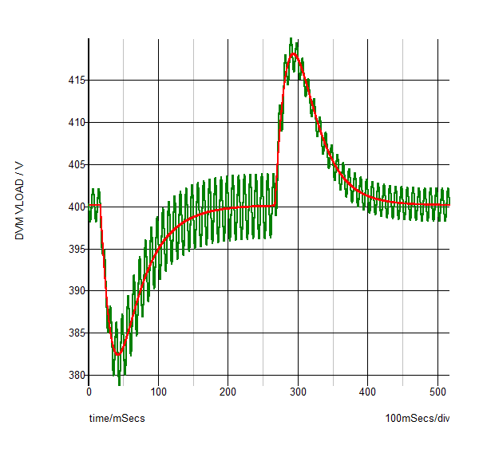
“Companion Circuit” Technique: Compare Load Transient on 115VAC / 115VDC Input
We now have high confidence
our POP/AC results from the
“Companion Circuit” are valid
for the original, AC Input Circuit
DC Input
AC Input
But, we can always
run a Multi-Tone
AC Analysis

Slide 35
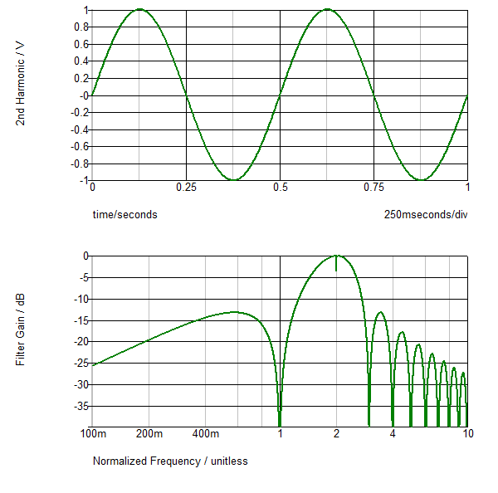
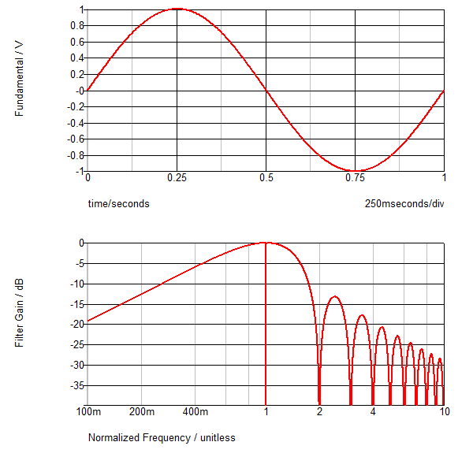
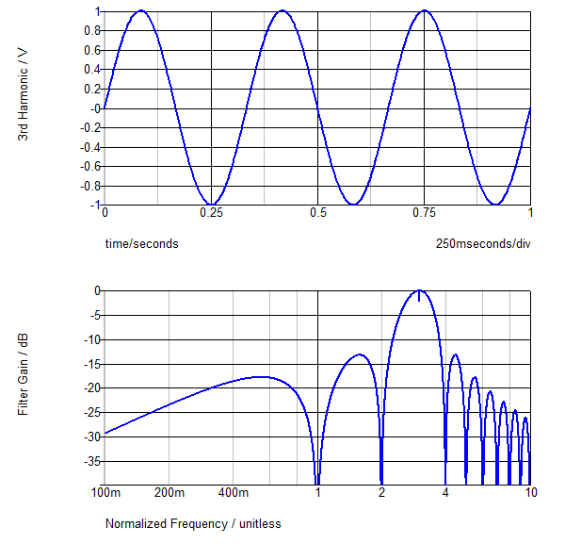
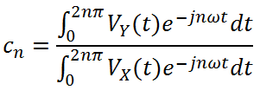
Numerical Fourier Analysis:
2nd Harmonic
3rd Harmonic
Injected Fundamental
Evaluate Fourier Integral at each Injected Frequency:
Filter Gain
Filter Gain
Filter Gain
D:\customer.simplistechnologies.com\examples\internal\multi-tone\source_testing\filter_response_1.sxscr
D:\customer.simplistechnologies.com\examples\internal\multi-tone\source_testing\filter_response_1.sxscr
2nd, 3rd, 4th, ... harmonics rejected
1st, 3rd, 4th … harmonics rejected
1st, 2nd, 4th … harmonics rejected
Inter-harmonics are not perfectly rejected!
Inter-harmonics are not perfectly rejected!
Inter-harmonics are not perfectly rejected!
2nd harmonic
3rd harmonic
Fundamental

Slide 36
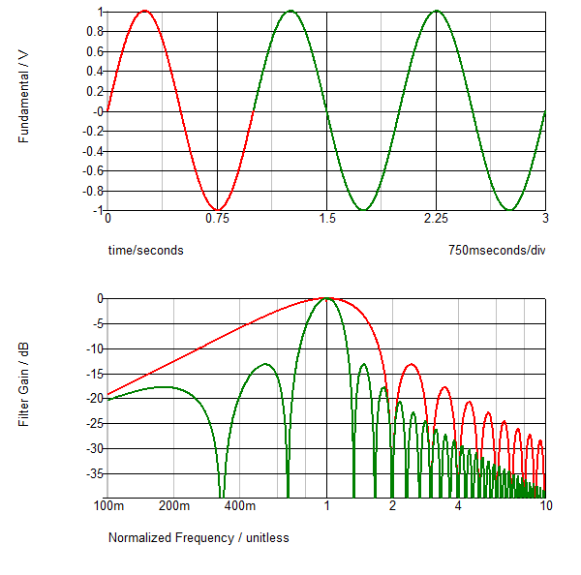
Numerical Fourier Analysis: Observations
↑ Fundamental to 3 Cycles
Injected Fundamental
Filter selectivity increases with harmonic number
Increasing the # of fundamental cycles greatly increases filter selectivity
Filter rejects sub harmonics
and higher inter-harmonics

Slide 37
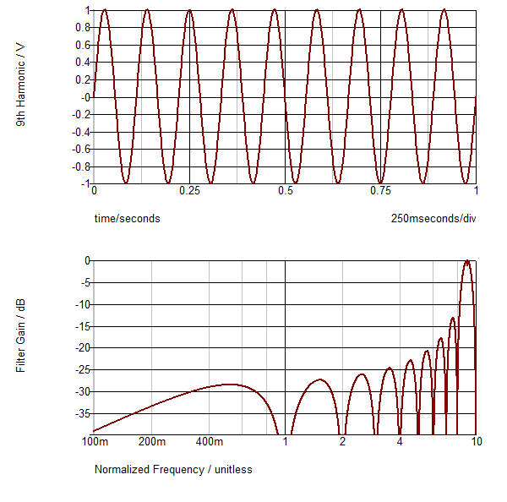
Numerical Fourier Analysis: Observations
9th Harmonic
Low Frequencies will pass through into all data, but will be more prevalent in lower harmonics…
Therefore the circuit must be very well settled or the AC data will be corrupted!
1/10th Harmonic: only 20dB rejection
Increase in rejection to 38dB when n → 9

